Slide 1
Comprehensive Digital Marketing Project Work

Slide 2
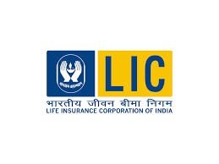
Part 1: Brand study, Competitor Analysis & Buyer’s/Audience’s Persona
COMPANY/TOPIC for project: Life Insurance Corporation of India
Research Brand Identity: Study the brand's mission, values, vision, and unique selling propositions (USPs).
Brand Colors:
Blue , yellow
Logo:
Mission/Values:
The mission of LIC (Life Insurance Corporation of India) is to provide financial security and protection to individuals and promote economic growth through life insurance and related products.
USP:
LIC (Life Insurance Corporation of India) is its status as a state-owned insurance provider with an extensive and trusted presence in the Indian market, offering financial security and stability to millions of policyholders.
Notes:
Mission:

Slide 3

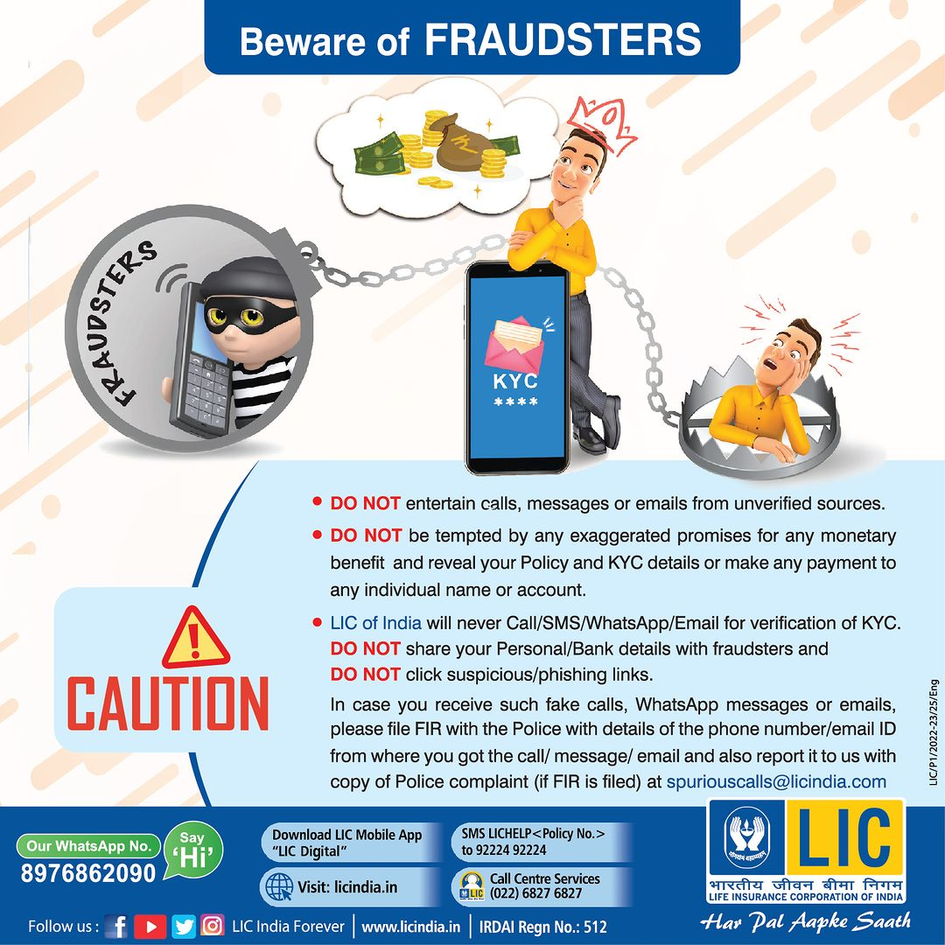
Part 1: Brand study, Competitor Analysis & Buyer’s/Audience’s Persona
COMPANY/TOPIC for project: Life Insurance Corporation of India
Analyze Brand Messaging: Creative, Informative & Awareness Content.
https://www.instagram.com/p/CvJGZ1RtgUg/?igshid=NTc4MTIwNjQ2YQ==
https://www.instagram.com/p/CvHKVyRS8_S/?igshid=NTc4MTIwNjQ2YQ==
Examine the brand's tagline:
Zindagi ke saath bhi, zindagi ke baad bhi.
Notes:
COMPANY/TOPIC for project:

Slide 4
Part 1: Brand study, Competitor Analysis & Buyer’s/Audience’s Persona
Competitor Analysis: Select three competitors operating in the same industry or niche as the chosen brand, examine their USPs and online communication.
Competitor 1: PROBUSINSURANCE
https://www.probusinsurance.com/
I recommend conducting an online search or visiting their official website to learn more about their services.
USP:
Provided toll free number add chat box
ONLINE COMMUNICATION:
Competitor 2:
POLICYX
https://www.policyx.com/
USP:
Policy allows users to compare various insurance products from different insurance companies in India.
ONLINE COMMUNICATION:
Provided toll free number add chat box
Competitor 3:
MYINSURANCECLUB
https://www.myinsuranceclub.com/
USP:
standards for medications,
United States Pharmacopeia (USP) is a non-profit organization that establishes quality
dietary supplements, and other healthcare products.
ONLINE COMMUNICATION:
Provided toll free number add chat box

Slide 5
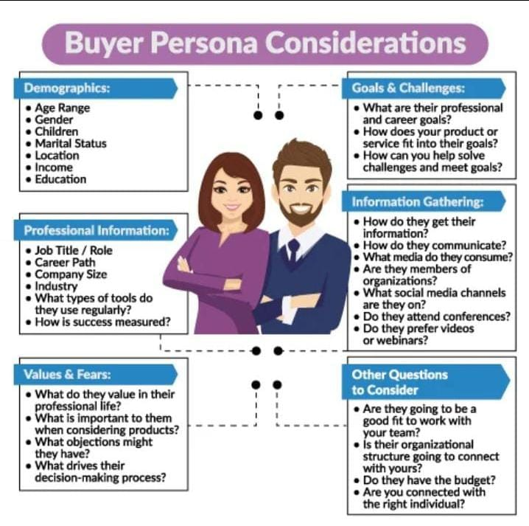
Part 1: Brand study, Competitor Analysis & Buyer’s/Audience’s Persona
Buyer's/Audience's Persona: Clearly define the target audience for the chosen brand. Consider demographics, psychographics, behaviors, and interests.
DEMOGRAPHICS:
AGE RANGE-
Above 18
Male and Female.
GENDER-
CHILDREN-
Children are eligible for life insurance coverage under LIC policies.
Married /Unmarried
MARITAL STATUS-
LOCATION-
2,00,000 to 2,50,000 Per annum
Educated/Non Educated
EDUCATION-
VALUES AND FEARS:
WHAT DO THEY VALUE IN THEIR PROFESSIONAL LIFE?-
In their professional life,
LIC values customer satisfaction and financial security.
WHAT IS THE IMPORTANT TO THEM WHEN CONSIDERING PRODUCTS?-
Customer
Needs and Demographics,
Risk Management and Actuarial Analysis,
Regulatory
Compliance,
Transparency and Clarity,
Customer Service and Support.
INFORMATION GATHERING:
HOW DO THEY GET THEIR INFORMATION?-
Application Forms,
Underwriting,
Medical Examinations,
Agents and Branches,
Online Platforms,
Policyholders.
Customer Care Centers,
Official Website,
Phone
HOW DO THEY COMMUNICATE?-
Support,
Social Media etc..
Email Communication
Mobile Apps,
, SMS Alerts,
Notes:
HOW DO THEY COMMUNICATE?-

Slide 6
Part 2: SEO & Keyword Research
SEO Audit: Do an SEO audit of the brands website
Keyword Research: Define Research Objectives, Brainstorm Seed Keywords, Utilize Keyword Research Tools (SEMrush or Moz Keyword Explorer),Analyze Competitor Keywords, Long-tail Keyword Exploration (specific, longer phrases) that align with the research objectives and have lower competition but higher conversion potential.
On page Optimization: Meta Tag optimization & content optimization
Reflect on the process of conducting keyword research and the SEO recommendations provided.
Document the challenges faced during the research and analysis phase, as well as the key insights gained from the keyword research process.

Slide 7
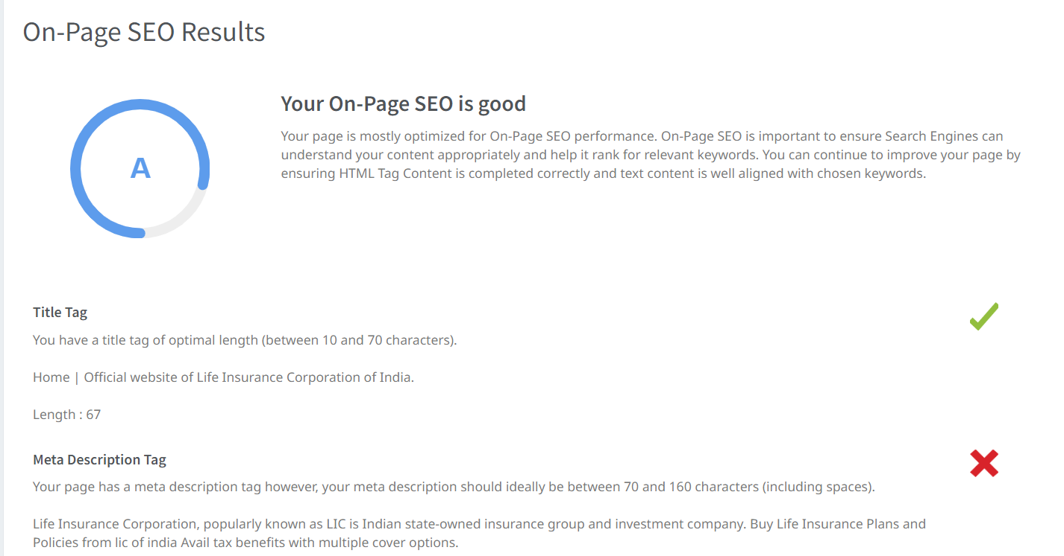
SEO Audit: Do an SEO audit of the brands website

Slide 8
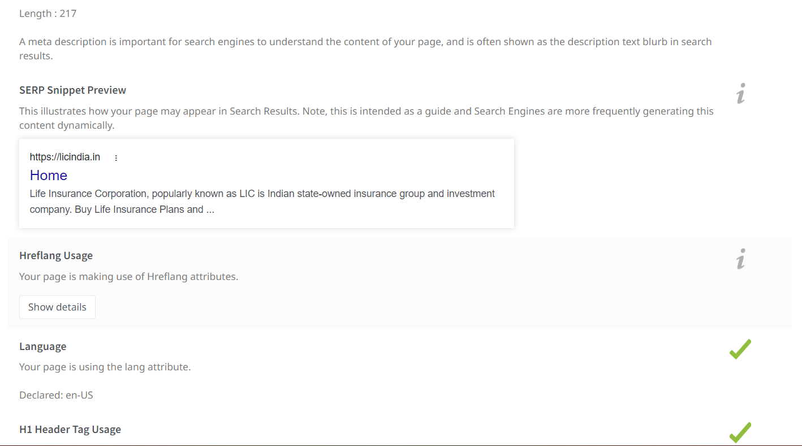

Slide 9
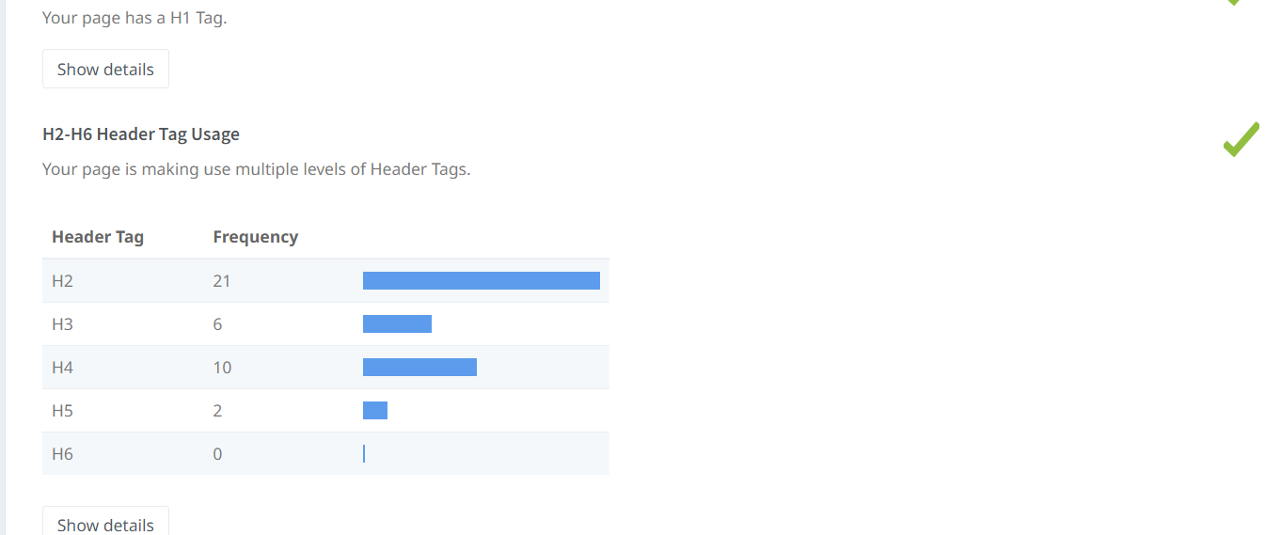

Slide 10
Policy
Keyword | Avg. monthly searches | Competition
home policy | 50 | Low
online health policy | 500 | High
pm life insurance policy | 50 | Low
META TITLE
Explore policies like home policy, Health policy , PM life insurance policy |  |  |  | 72
META DESCRIPTION
Apply new featured policies like Home policy, Health policy & PM life insurance policy at LIC 94
Premium
Keyword | Avg. monthly searches | Competition
health policy premium | 50 | High
critical illness premium | 50 | High
medical policy premium | 500 | High
META TITLE
Explore premium like health policy ,critical illness , medical policy |  |  |  | 67
META DESCRIPTION
Check eligibility apply premium like health policy , critical illness , medical policy |  |  |  | 82

Slide 11
Plans
Keyword | Avg. monthly searches | Competition
health insurance plans | 50000 | High
home insurance plans | 500 | Low
money back plans | 500 | Low
META TITLE
Find the best plans like health insurance , home insurance , money back |  |  |  | 67
META DESCRIPTION
Apply featured plans like health insurance , home insurance , money back |  |  |  | 68
Investment
Keyword | Avg. monthly searches | Competition
unit linked investment | 50 | Medium
best life insurance policy for investment | 50 | High
health insurance plus investment | 50 | Medium
META TITEL
Check the investment unit linked , health insurance plus , ulip |  |  |  | 59
META DESCRIPTION
Apply now for the investment like unit linked , health insurance plus , ulip |  |  |  | 72

Slide 12
Coverage
Keyword | Avg. monthly searches | Competition
life and health coverage | 50 | Unknown
property insurance coverage | 500 | Low
medical coverage | 500 | Low
META TITLE
Explore coverage like life and health , property insurance , medical |  |  | 64
META DESCRIPTION
Apply now featured coverage like life and health, property insurance , medical |  |  | 76

Slide 13
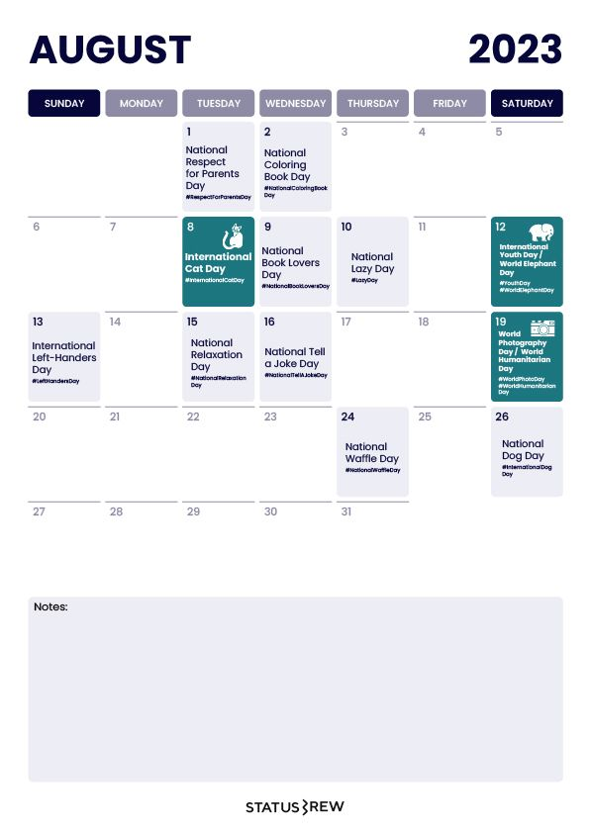
Part 3: Content Ideas and Marketing Strategies
Content Idea Generation & Strategy: Create a content calendar for the remaining month of July by brainstorming content themes, exploring various formats like blog posts, videos, infographics, podcasts, and interactive quizzes, and scheduling publication dates mainly on Facebook & Instagram.
And include the strategy, aim and the idea behind these posts and story
Content Calendar Example (Try creating a table for the month of July)

Slide 14
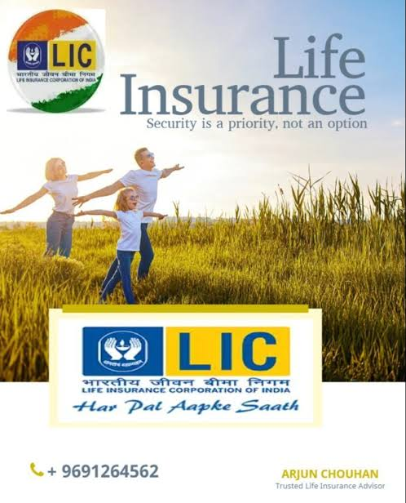


Part 3: Content Ideas and Marketing Strategies
Reflect on the content ideas and marketing strategies process, discussing the challenges encountered and lessons learned.
DATE: 21st august 2023
To offer life insurance policies that provide financial security to
policyholders and their families
policyholders and their families.
are protected against various risks.
DATE: 22 august 2023
To Awareness on Life insurance policy.
Information about life insurance corporation of India.
of Life insurance
This video visualise the Importance
Corporation of India.
DATE: 23 august 2023
To create awareness on fake calls
To create a meme on fake calls
Notes:
DATE:

Slide 15
Creating content ideas and devising effective marketing strategies is a dynamic process that involves continuous learning and adaptation. Throughout this journey, several challenges and valuable lessons
can be encountered.
1.Understanding the Audience: One of the primary challenges is comprehending the target audience’s preferences, needs, and pain points.
2. Generating Unique Ideas: Coming up with fresh and innovative content ideas can be difficult, especially in saturated markets. 3. Consistency and Quality: Maintaining a consistent flow of high-quality content can be demanding. Setting up an editorial calendar and adhering to a content creation schedule helps in maintaining quality and meeting deadlines.
4. Content Promotion: Even the best content may not gain traction without proper promotion. Crafting effective marketing strategies to reach the target audience across various channels is crucial for success.
5. Collaboration: Collaborating with influencers or other brands can amplify the reach of content and strengthen marketing efforts.
The content ideas and marketing strategies process is an iterative and learning-oriented journey.

Slide 16
Part 4: Content Creation and Curation (Post creations, Designs/Video Editing, Ad Campaigns over Social Media and Email Ideation and Creation)
Post Creation:
Select Content Categories: Identify three different content formats relevant to the chosen topic or industry. Research and Brainstorm: Research trending topics, industry news, or audience interests within each category. Brainstorm ideas for social media posts that align with each category. Do note that 1 content format has to be video and additionally 3 stories/status are to be created.
Format 1:Blog article
Format 2:Video
Format 3:Creative

Slide 17
Part 4: Content Creation and Curation (Post creations, Designs/Video Editing, Ad Campaigns over Social Media and Email Ideation and Creation)
Format 1:Blog Article
Aim:
Date:21-08-2023
Idea:
To offer life insurance policies that provide financial security to policyholders and their families
policyholders and their families are protected against various risks.
Topic:
Step 1: Market Research and Analysis
LIC conducts extensive market research and analysis to understand the evolving needs and preferences of potential customers.
The research involves studying demographic trends, economic conditions, and changes in the insurance industry to identify market demands and gaps.
Step 2: Product Development
Based on the market research findings, LIC's product development team designs a diverse range of life insurance policies to cater to different customer segments.
The team creates policies with varying coverage options, benefits, premium structures, and policy terms.
Notes:
Topic:

Slide 18
Step 3: Affordability Assessment
LIC ensures that the life insurance policies are affordable for a wide range of income groups.
The company calculates premiums based on actuarial analysis to strike a balance between providing adequate coverage and keeping the policies accessible.
Step 4: Customization Options
Recognizing that individual financial requirements differ, LIC allows policyholders to customize their insurance plans.
Policyholders can choose the coverage amount, policy term, and additional riders (optional benefits) to tailor the policy to their specific needs.
Step 5: Agent Network
LIC maintains a dedicated team of agents who serve as intermediaries between the company and potential policyholders.
Agents undergo comprehensive training to understand the policies thoroughly and provide appropriate guidance to customers.
Step 6: Customer Education and Awareness
LIC conducts awareness campaigns and financial literacy programs to educate the public about the importance of life insurance and financial planning.
These initiatives help individuals make informed decisions about their insurance needs.
Step 7: Customer Engagement
LIC interacts with potential customers through various channels, such as physical branches, online portals, and customer service centers.
This engagement process helps understand customers' requirements better and assists them in choosing the most suitable policy.

Slide 19

Part 4: Content Creation and Curation (Post creations, Designs/Video Editing, Ad Campaigns over Social Media and Email Ideation and Creation)
Format 2:Video
Aim: To Awareness on Life insurance policy
Date: 22-08-2023
Idea: Information about life insurance corporation of India
Topic: This video visualised the Importance of Life insurance Corporation of India

Slide 20
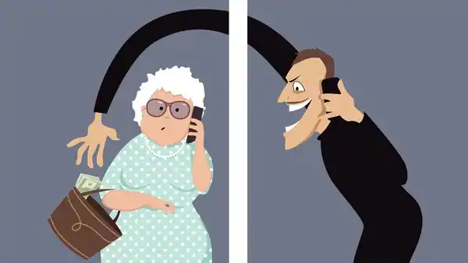
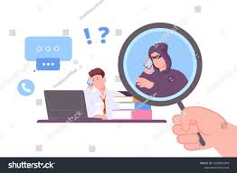
Part 4: Content Creation and Curation (Post creations, Designs/Video Editing, Ad Campaigns over Social Media and Email Ideation and Creation)
Format 3: Creative
Aim: To create awareness on fake calls
Date: 23-08-2023
Idea: To create a meme on fake calls
Topic: Meme

Slide 21
Part 4: Content Creation and Curation (Post creations, Designs/Video Editing, Ad Campaigns over Social Media and Email Ideation and Creation)
Instagram Story
Utilize the Stories feature on Instagram for three consecutive days. Share behind-the-scenes glimpses, polls, quizzes, or sneak peeks etc to encourage audience participation. Once uploaded use the story highlight feature on Instagram and save the 3 story with an appropriate name for each.
Note:
Once done monitor the performance of the posts and Stories using the insight tool and analyze the engagement metrics (likes, comments, shares, impressions, etc.). Based on the analysis, mention the strategies and areas for improvement.

Slide 22
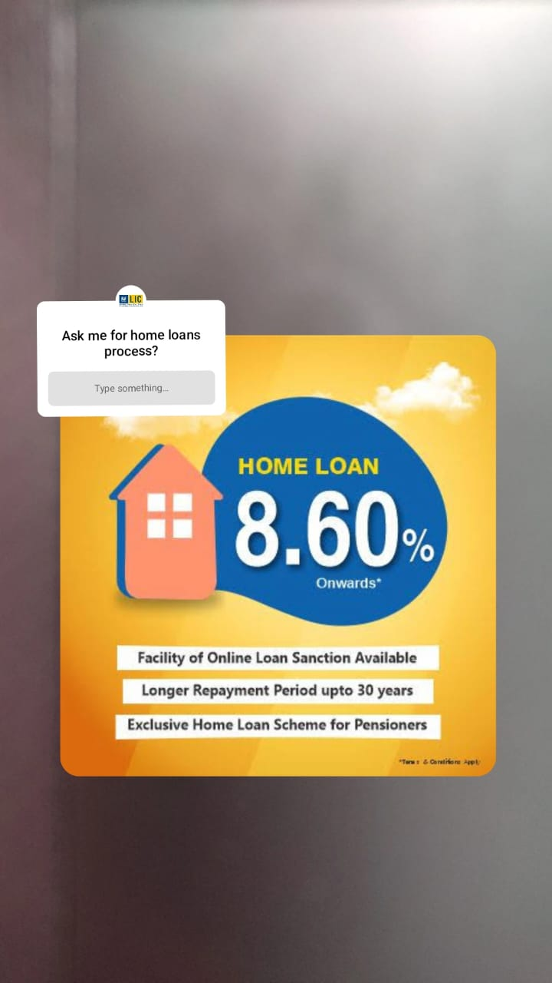
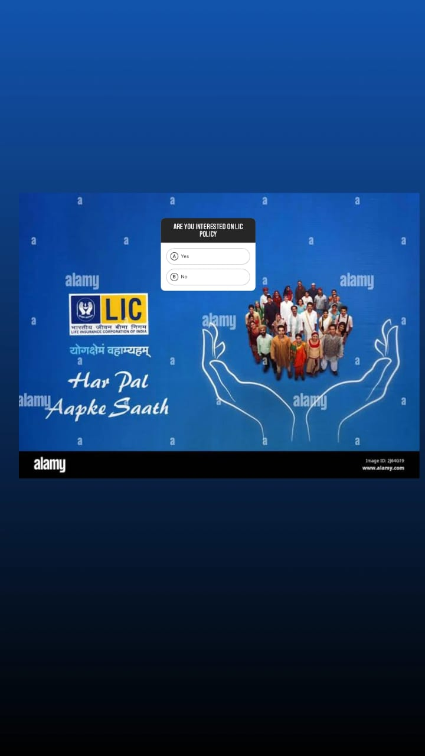
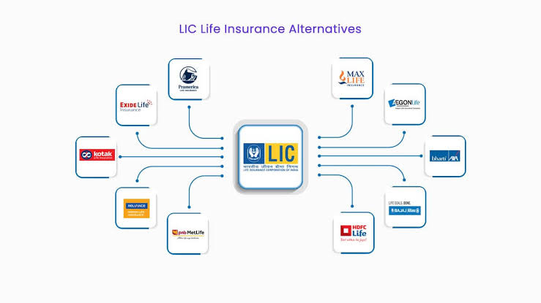
Part 4: Content Creation and Curation (Post creations, Designs/Video Editing, Ad Campaigns over Social Media and Email Ideation and Creation)
Instagram Story

Slide 23
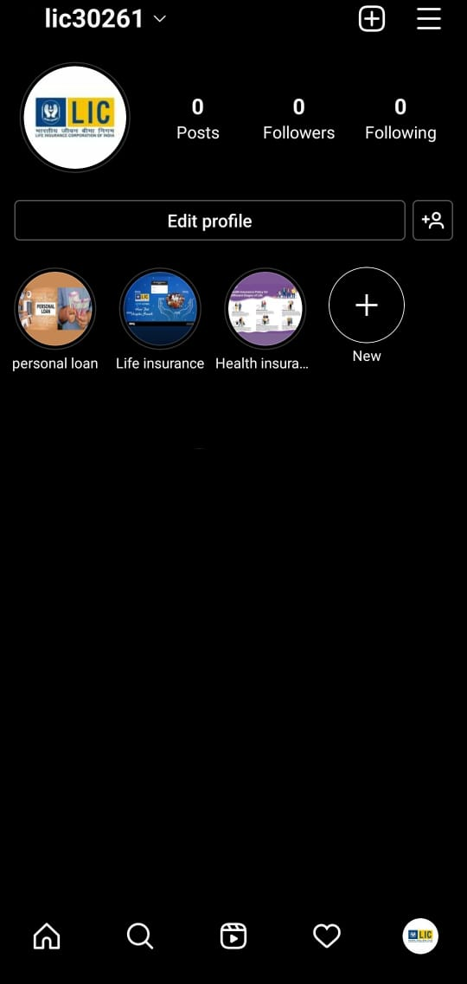

Slide 24
Part 4: Content Creation and Curation (Post creations, Designs/Video Editing, Ad Campaigns over Social Media and Email Ideation and Creation)
Designs/Video Editing
Design Tools Familiarization (use Canva for creating visually appealing graphics)
Video Creation: Utilize VN or any video editor of your choice to create videos related to the chosen topic.

Slide 25
Part 4: Content Creation and Curation (Post creations, Designs/Video Editing, Ad Campaigns over Social Media and Email Ideation and Creation)
Social Media Ad Campaigns
Ad Campaigns over Social Media:
Come up with 3 ad campaigns each covering one of the mentioned goals: brand awareness, driving website traffic, or generating leads

Slide 26
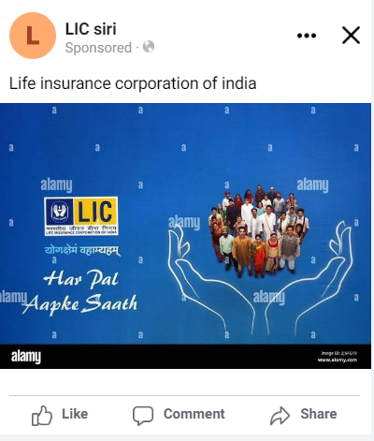
Brand Awareness:
Targeting: Location : India , All genders,
Age , Interest : Health insurance, General Insurance, Home Insurance, Life insurance.

Slide 27
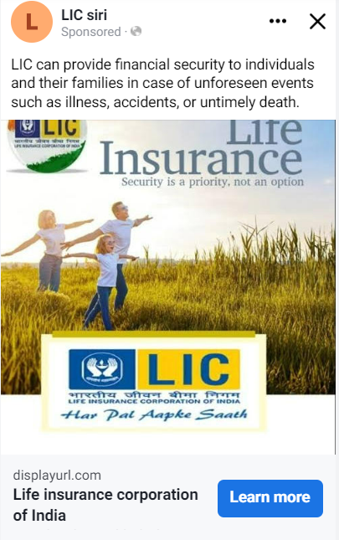
Driving website traffic:
Targeting: Location : India , All genders,
Age , Interest : Health insurance, General Insurance, Home Insurance, Life insurance.

Slide 28
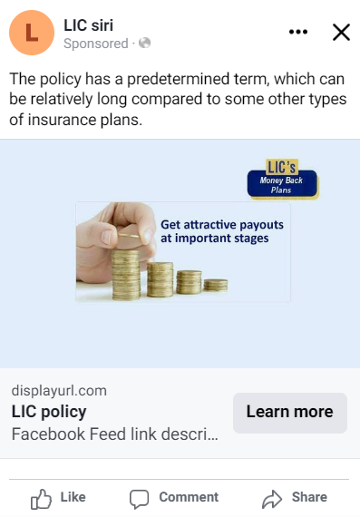
Generating Leads:
Targeting: Location : India , All genders,
Age , Interest : Health insurance, General Insurance, Home Insurance, Life insurance.

Slide 29
Part 4: Content Creation and Curation (Post creations, Designs/Video Editing, Ad Campaigns over Social Media and Email Ideation and Creation)
For every campaign clearly define:
Advertising Goals: increasing brand awareness, driving website traffic, or generating leads.
Audience Targeting: Define the target audience for the ad campaigns based on demographics, interests, and behavior.
Ad Creation: Create visually appealing ad creatives, compelling ad copy and relevant call-to-action.

Slide 30
Part 4: Content Creation and Curation (Post creations, Designs/Video Editing, Ad Campaigns over Social Media and Email Ideation and Creation)
Email Ad Campaigns
Ad Campaigns for email marketing:
Come up with 2 email ad campaigns with the mentioned goals: brand awareness & generating leads

Slide 31
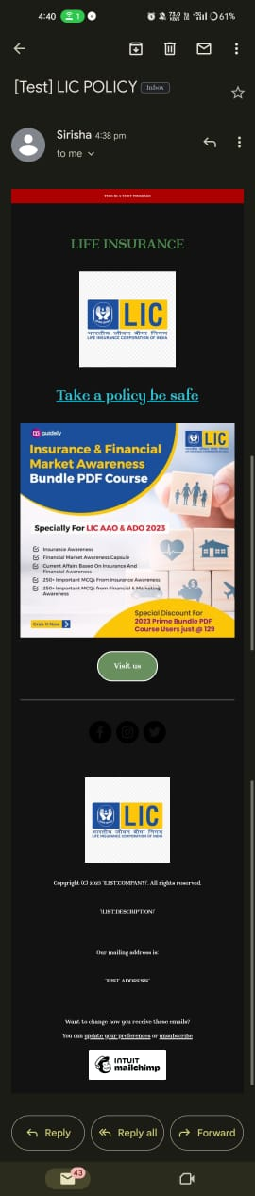
Email Ad Campaign 1 - Brand Awareness
(insert emailer image)

Slide 32
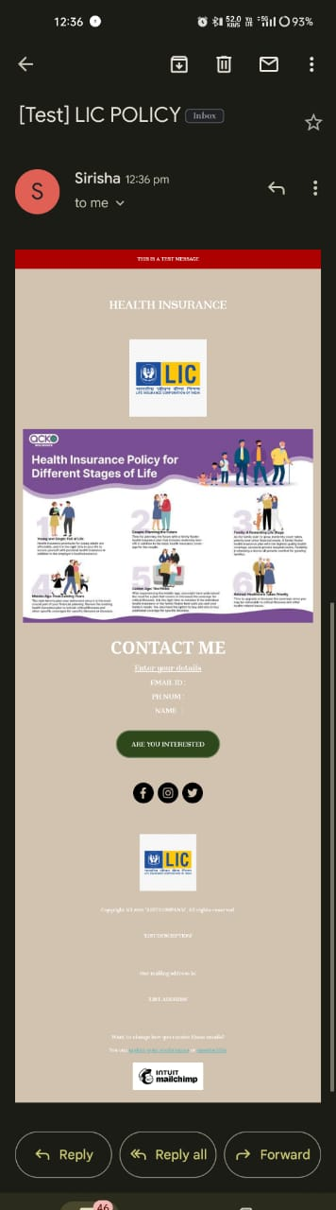
Email Ad Campaign 2 - Lead Generation
(insert emailer image)

Slide 33
Part 4: Content Creation and Curation (Post creations, Designs/Video Editing, Ad Campaigns over Social Media and Email Ideation and Creation)
Reflect on the content creation and curation process, discussing the challenges faced and lessons learned.
1.Know our Audience: Understanding the target audience's interests, pain points, and preferences is fundamental
2.Visual Appeal: Eye-catching visuals, well-designed graphics, and professionally edited videos can significantly
enhance the impact of content and ad campaigns.
3. Consistency is Key: Maintaining a consistent tone, style, and frequency of content across platforms helps reinforce
brand identity and improves audience recall.
4. A/B Testing: Regularly conducting A/B + tests for ad campaigns and email subject lines allows for data-driven optimization and better results.
5. Engage with the Audience: Responding to comments, messages, and feedback from the audience fosters a sense
of community and builds trust.
6. Long-Term Approach: Content creation and marketing are not one-time endeavors. A long-term, strategic approach is necessary to build brand awareness and achieve sustainable growth.
In conclusion, content creation and curation, along with thoughtful design, video editing, and well- executed ad campaigns, play a pivotal role in a successful marketing strategy. By understanding the challenges and incorporating the lessons learned, businesses can create compelling content that resonates with their target. audience and drives results
in creating relevant and engaging content.

